Slide 1

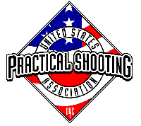
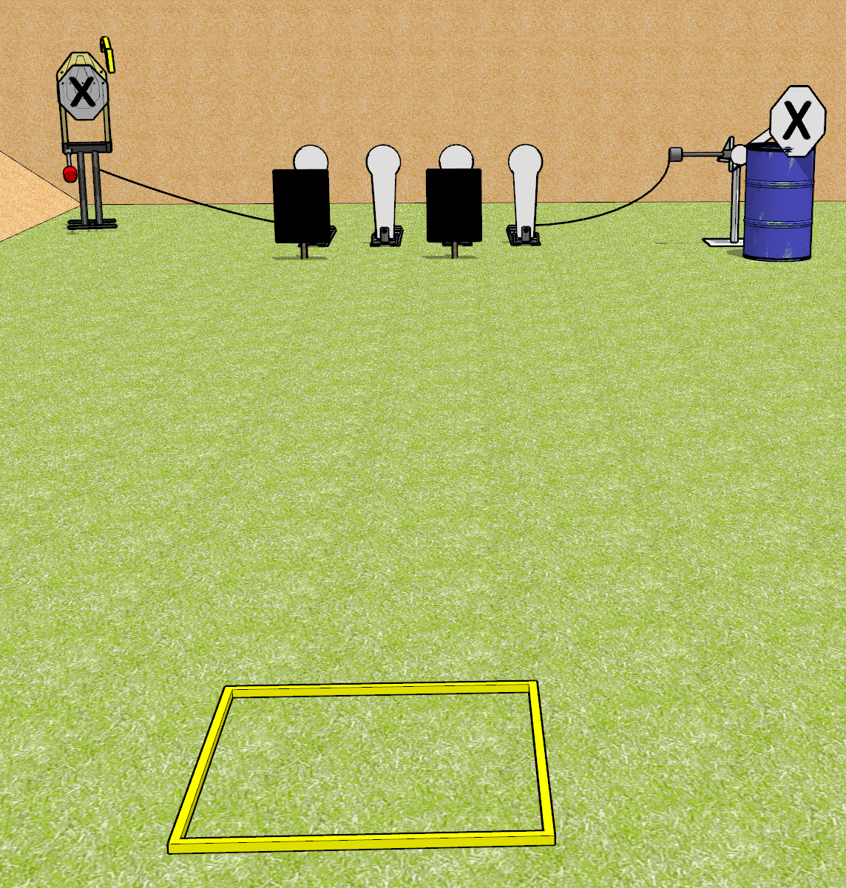
 | Dothan Gun Club – USPSA Match Be Quick Course Designer : Drew Coleman
START POSITION : Standing toes touching rear of shooting box, facing uprange. Wrists above respective shoulders. PCC buttstock on belt pointed in a safe direction.
GUN READY CONDITION : Pistol loaded and holstered. PCC loaded and held with both hands, buttstock on belt pointed in a safe direction. |  | SCORING: Comstock, 8 rounds TARGETS: 1 paper, 6 Steel SCORED HITS: Best 2 on paper, steel until down START-STOP: Audible, last shot RULES:
STAGE PROCEDURE: Engage targets as they become available from within the fault lines

